Slide 1
Our Water in Memphis
Aquifer in a Cup

Slide 3
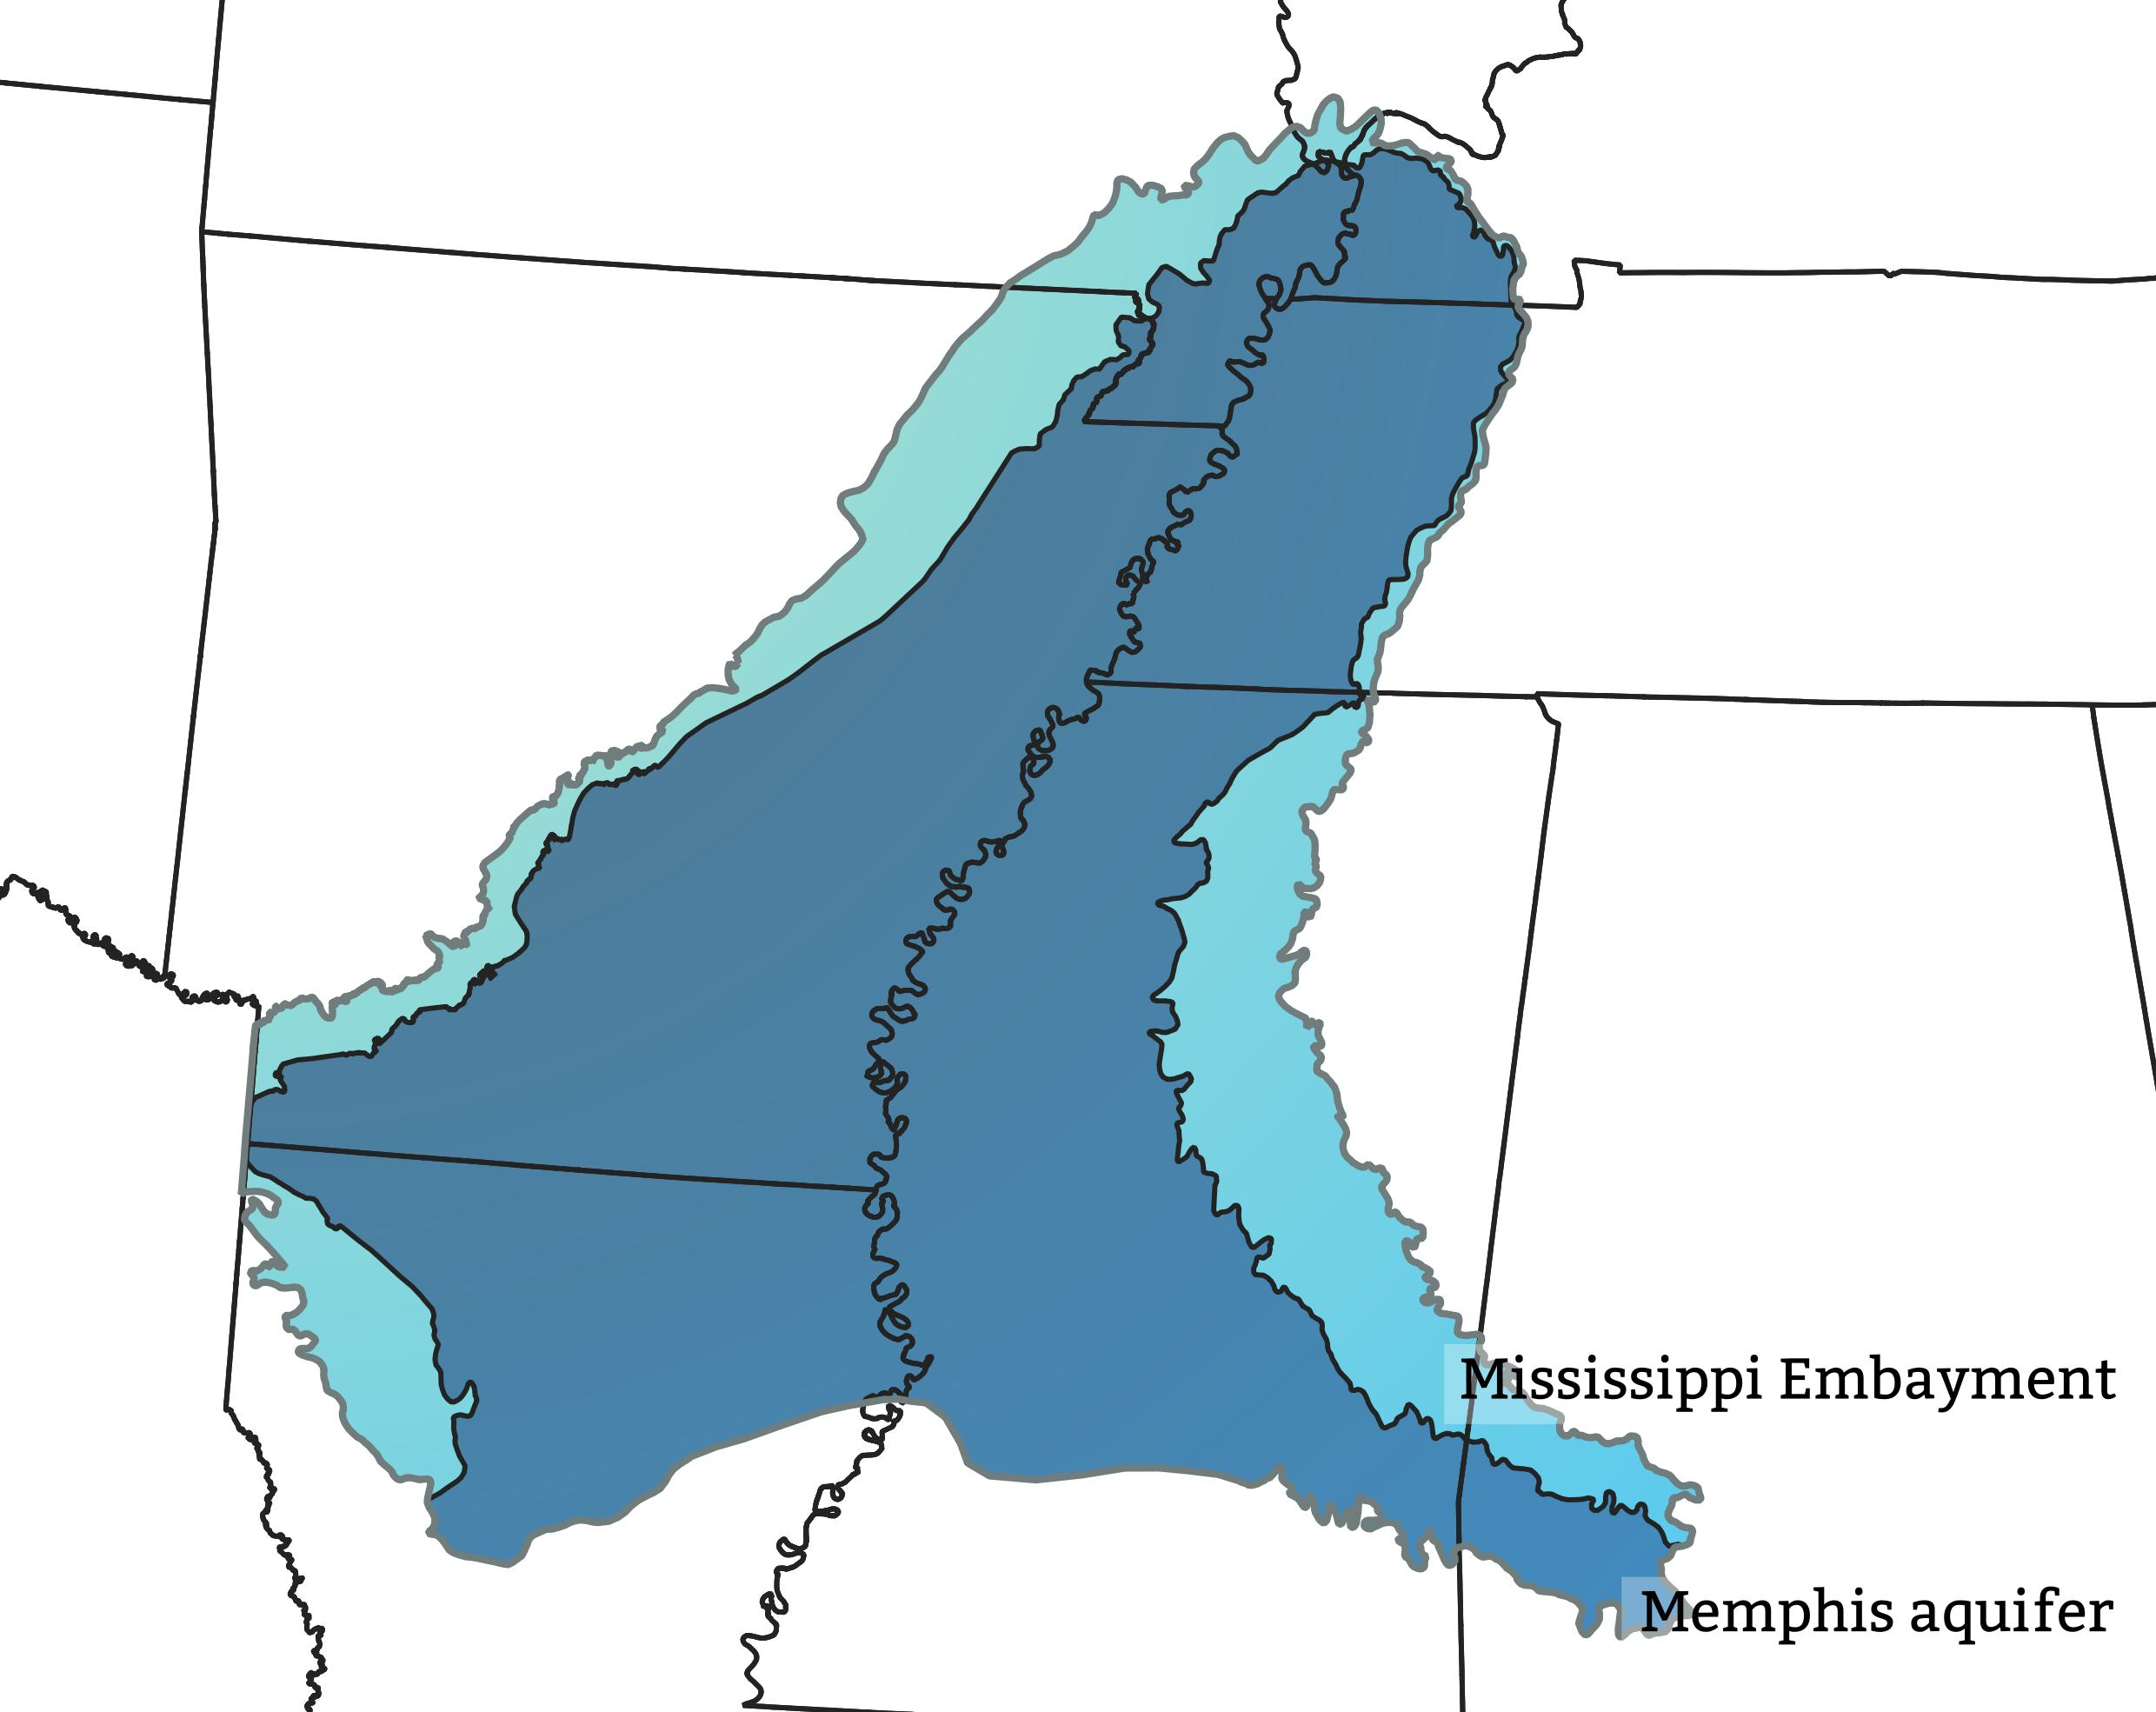
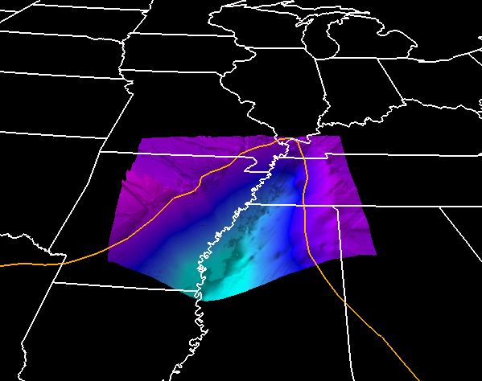
Mississippi Embayment
The groundwater resources below ground extend into eight states! This was formed 70 million years ago and is very special to West Tennessee.
View From Above
View of the “Bowl”
Arkansas
Tennessee
Mississippi
Notes:
Formed over 70 million years ago from a seismic event that made the land sink and the ocean to wash inland. Tidal flows in and out over the millions of years deposited different layers of sediment that make up a multi-layer aquifer systems in the region. The black images depicts the “bowl” shape that is underground.

Slide 4
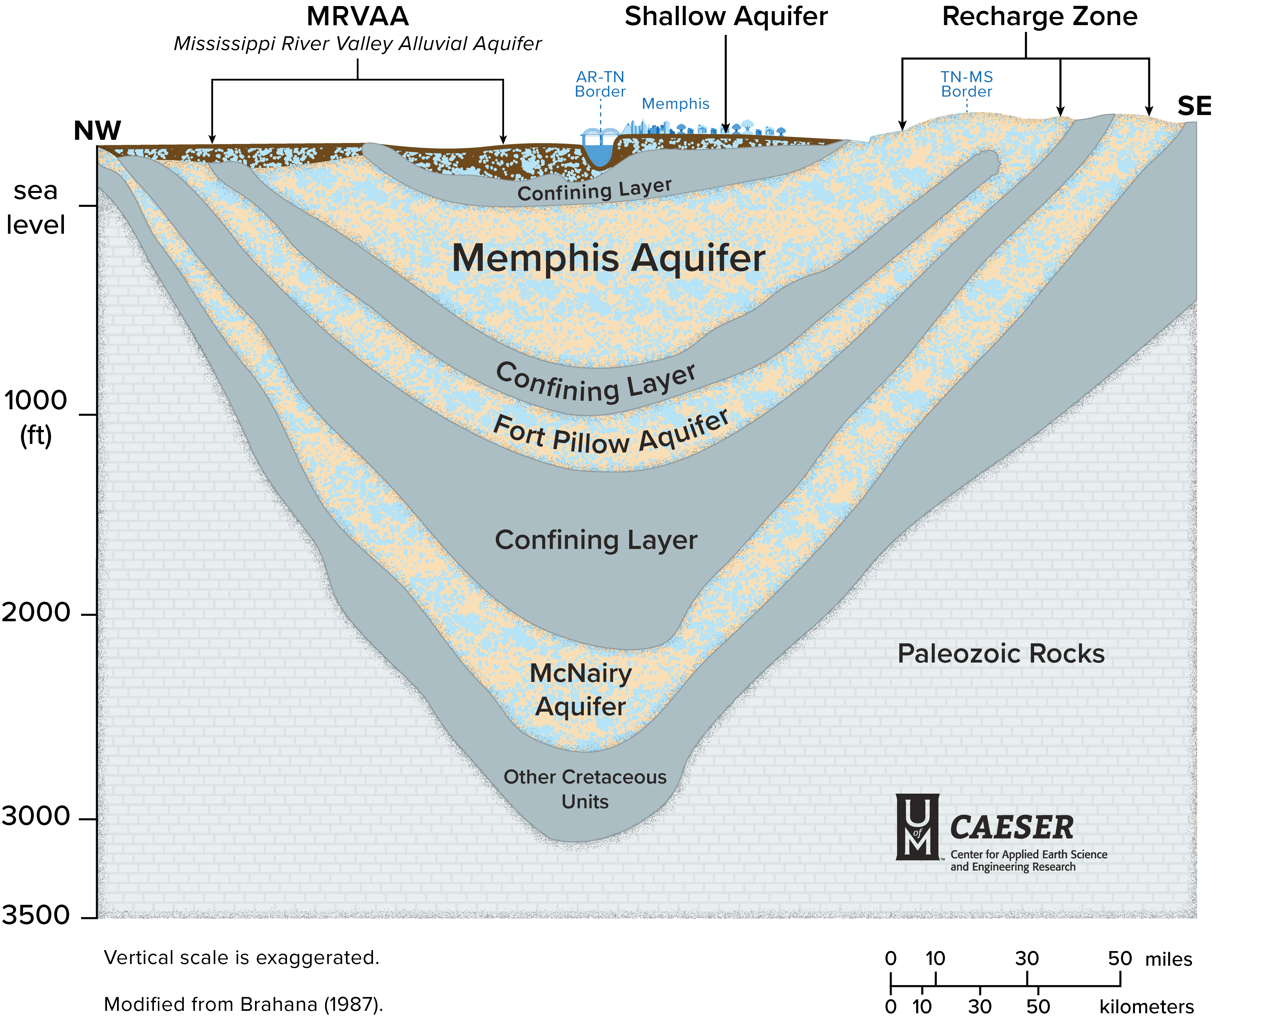
Our Water Underground
Notes:
Here is a cross-section view of what lies beneath our feet! The blight brown layers are clouds, the yellow layers are the aquifers. The Memphis aquifer is the layer of sand that holds the water Memphis uses today. Most water is between 2,000-3,000 years old and very pure! The clay layer above it “Upper Claiborne confining unit” keeps surface level pollution out of our drinking water supply. That’s why Memphis water really is one of the freshest, cleanest sources of drinking water in the USA!

Slide 5
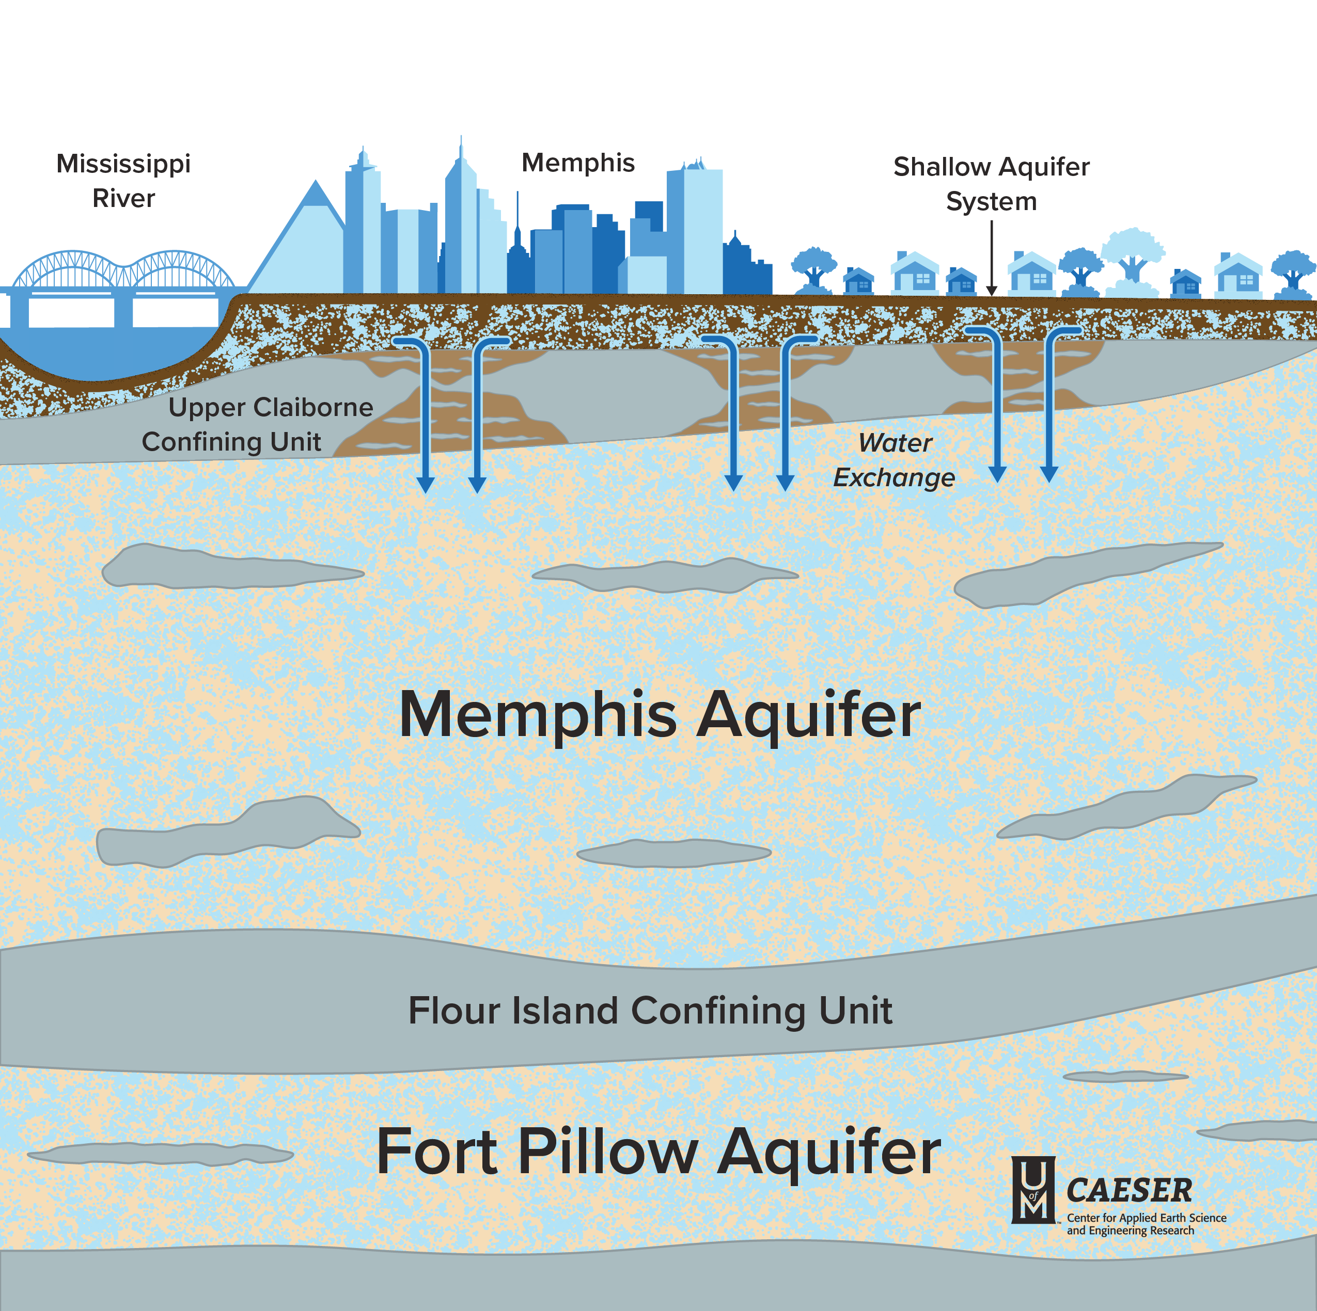
Our Water Underground
Notes:
Here is a cross-section view of what lies beneath our feet! The blight brown layers are clouds, the yellow layers are the aquifers. The Memphis aquifer is the layer of sand that holds the water Memphis uses today. Most water is between 2,000-3,000 years old and very pure! The clay layer above it “Upper Claiborne confining unit” keeps surface level pollution out of our drinking water supply. That’s why Memphis water really is one of the freshest, cleanest sources of drinking water in the USA!

Slide 6
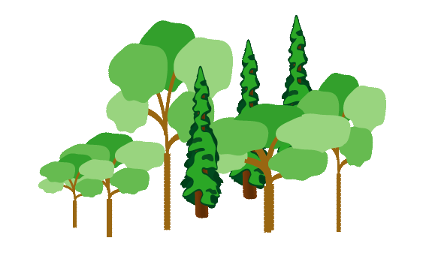
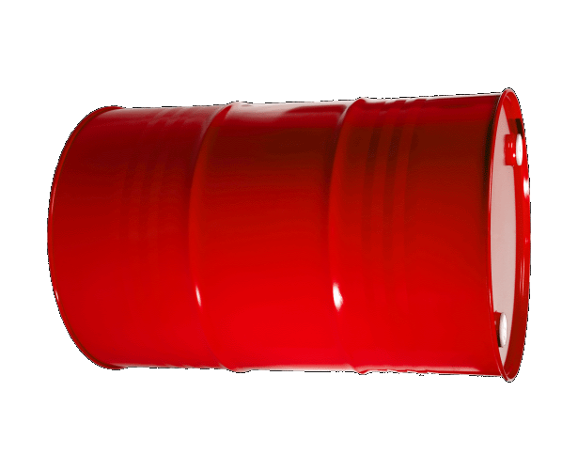
Breach
Shallow
aquifer
confining clay
Memphis
aquifer
Notes:
We’ve discovered that the clay layer above the Memphis aquifer has natural holes or “breaches” that CAN allow pollution in. CAESER is studying those right now to find where they are and if pollution is close in order to keep our drinking water the cleanest in the nation.

Slide 7
How to Build an Aquifer in a Cup​
Start with a clear surface and cover it – we might get messy!
Put a clear, see-through cup on the table. Fill it with a small amount of sand.​
Get a small piece of clay and roll it around in your hands to make a ball. Then, flatten it into a pancake and fold the pancake in half.​
Place the folded clay into the cup covering half of the sand. Push the round edge of the clay into the edge of the cup so that it sticks to the plastic side. ​
Add a thin layer of gravel to the top of the cup, just covering the other materials. ​
Pour water into the cup to cover the layers. Observe what happens as
the water enters the sand. ​
7. Add one or two drops of food coloring to the cup to represent pollution. ​
8. Observe the slow speed of water/pollution traveling into the sand
9. Add a straw into the cup to represent a well.

Slide 8
